Slide 1
Engineering Management
Leading Technical People
Lecture 789

Slide 2
Objectives
Explain the differences between leaders and managers.
Describe the nature of leadership and its significance to an organization.
Address the application of servant leadership in current organizations.
Recognize the different views of motivation.

Slide 3
Leadership and Management.
The words leadership and management are often used interchangeably, yet they describe two different concepts.
Maccoby defines leadership as a relationship between the leader and the led, and management as a function.
The leader uses passion and emotion, while the manager uses a more formal, rational method.
Managers are quite often experienced in their field and have worked their way up within the company; and a leader may be a new arrival to a company, with fresh ideas.

Slide 4
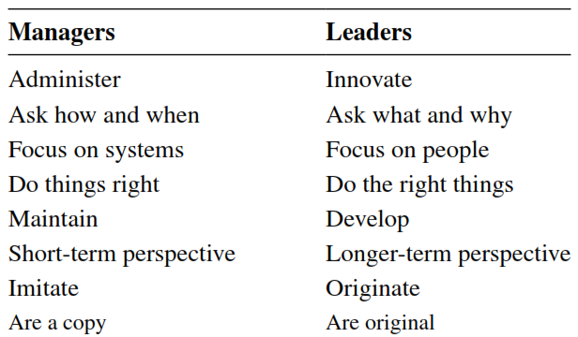
Leadership and Management.

Slide 5
Nature of Leadership
Leadership is the process of getting the cooperation of others in accomplishing a desired goal.
Sir William Slim, commander of the British Army that defeated the Japanese in Burma in World War II, defined leadership as that “mixture of persuasion, compulsion, and example that makes men do what you want them to do.”
In a more subtle vein, Barney Frank said, “The great leader is the one who can show people that their self-interest is different from that which they perceived.”

Slide 6
Nature of Leadership
Emergent, or informal, leaders evolve from their expertise or referent power as it is expressed in the process of group activity.
When the emergent leader is then appointed or elected as a formal leader, they have a double opportunity to be effective.

Slide 7
Leadership Traits.
Physical qualities of health, vitality, and endurance
Personal attributes of personal magnetism, cooperativeness, enthusiasm, ability to inspire, persuasiveness, forcefulness, and tact
Character attributes of integrity, humanism, self-discipline, stability, and industry
Intellectual qualities of mental capacity, ability to teach others, and a scientific approach to problems

Slide 8
Leadership continuum.
Autocratic (Telling). Manager makes decisions with little or no involvement of Non managers.
Diplomatic (Selling). Manager makes decisions without consultation but tries to persuade non managers to accept them (and might even modify them if they object strongly).
Consultative (Consulting). Manager obtains non managers’ ideas and uses them in decision making.
Participative (Joining). Manager involves non managers heavily in the decision (and may even delegate the decisions to them completely).

Slide 9
Components of Leadership
Have a set of beliefs. The essence of leadership is that people know what you stand for.
Be optimistic. No one follows a pessimist. A leader must appeal to people’s hopes, dreams, and aspirations.
Understand courage. Having courage is not about being fearless, but rather about having fear, recognizing it, and overcoming your fear.
Prepare relentlessly. Leadership is intensive preparation.
Create a strong team. To create a strong team, first recognize your own weaknesses.
You can then create a balanced team by finding people who compensate for the areas of your weakness.
Communicate. Explain to people what you need of them and what direction you want them to go in. Also, communicate by example or action.

Slide 10
Servant Leadership
Some of the actions the servant leaders do are:
Devote them selves to serving the needs of the organization Members.
Focus on meeting the needs of those that they lead.
Develop employees and facilitate personal growth.
Coach others and encourage self-expression.
Listen and build a sense of community.

Slide 11
Motivation
Robbins defines motivation in an organizational sense as
“The willingness to exert high levels of effort to reach organizational goals, conditioned by the effort’s ability to satisfy some individual need.”

Slide 12
Content theories
Maslow’s hierarchy of needs. One of the earliest and most influential content theories is the concept of Abraham H. Maslow that “human needs arrange themselves in hierarchies of prepotency. That is, the appearance of one need usually rests on the prior satisfaction of another.”
Physiological needs. At the lowest level of the hierarchy are physiological needs. People concentrate on these needs before continuing up the hierarchy to satisfy higher-order needs. In the Workplace these include basic wages or salary, and reasonable working conditions.
Security/safety needs. Next in the hierarchy, workers need job security, safe working conditions, protection against threats, and a predictable work environment.

Slide 13
Content theories
Affiliation needs. After the lower levels of the hierarchy, physiological and security, have been met, affiliation needs become a motivator for the worker. In the workplace these include compatible coworkers and a pleasant supervisor.
Esteem needs. Esteem needs are met by self-respect or self-esteem, and the esteem of others. Praise, recognition, and promotion within the company satisfy these needs. In some situations this includes the location of a person’s office.
Self-actualization needs. The highest level is the desire to become everything one is capable of becoming (to become actualized in what one is potentially). This need may be addressed through creative or challenging work or special assignments.

Slide 14
Differences among technical Professionals
scientists versus engineers.
Scientists and engineers often differ in significant ways.
Even as undergraduates, science students place higher value on independence and learning for its own sake; engineers are more concerned with professional preparation, success, and family life.
The true scientist is commonly assumed to have a doctorate; the typical engineer generally begins professional practice with a Bachelor of Science degree, and he or she typically earns a master’s degree later.
The scientist puts a high value on professional autonomy and publication of results; the engineer is a team worker and places little value on publication.

Slide 15
Leading technical Professionals
Dimensions of technical Leadership. Rosenbaum believed that to facilitate achievement of individual and group goals, successful technical leaders should master “five strategic dimensions”:
1.Coach for peak performance. “Listen, ask, facilitate, integrate, provide administrative support” act as a sounding board and supportive critic; help the professional manage change.

Slide 16
Leading technical Professionals
2. Run organizational interference. Obtain resources, act as advocate for the professional and his or her ideas, and minimize the demands of the bureaucracy (time and paperwork) on the professional.

Slide 17
Leading technical Professionals
3. Orchestrate professional development. Facilitate career development through challenging assignments; foster a business perspective in professionals; find sources where new areas of knowledge are required.

Slide 18
Leading technical Professionals
4. Expand individual productivity through teamwork. Make sure teams are well oriented regarding goals and roles, and that they get the resources and support they need.

Slide 19
Leading technical Professionals
5. Facilitate self-management. Assure that technical professionals are empowered to make their own decisions by encouraging free two-way information flow, delegating enough authority, and providing material and psychological support.

